Slide 1

Chi Square Test For Goodness of Fit
Hypothesis Testing - V

Slide 2
Chi-Square Distribution
A Chi-square distribution is a continuous distribution with k degrees of freedom. They’re widely used in hypothesis tests including the chi-square goodness of fit test and the chi-square test of independence.
It is also used to test the goodness of fit of a distribution of data, whether data series are independent, and for estimating confidences surrounding variance and standard deviation for a random variable from a normal distribution.
Chi-square distribution is a special case of the gamma distribution.

Slide 3
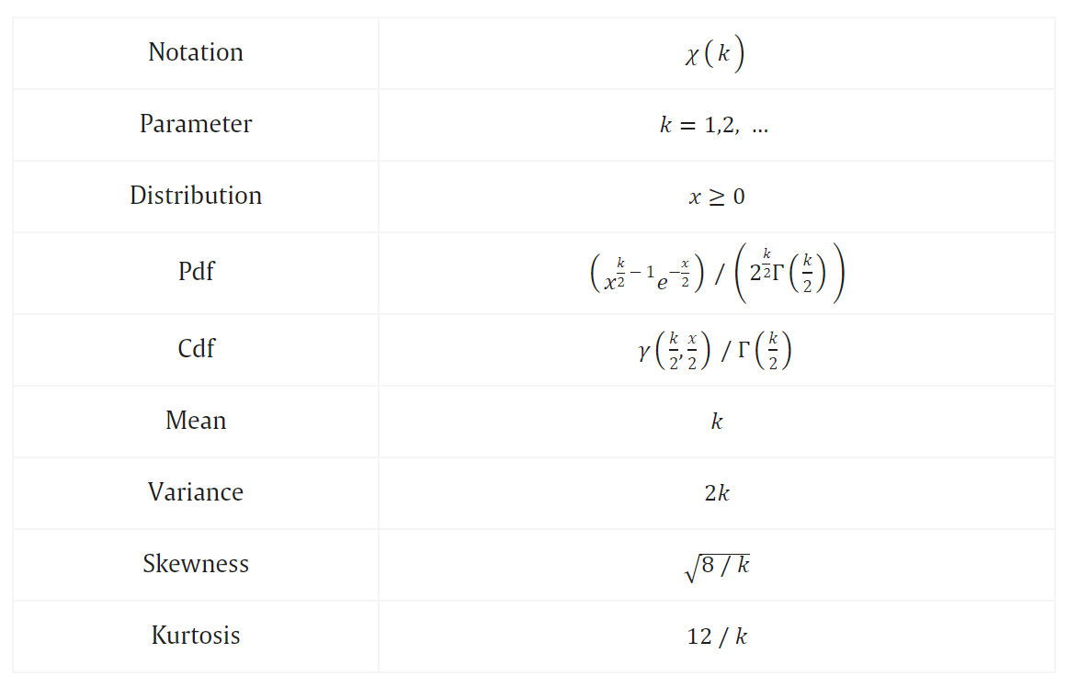
Chi-Square distribution Statistics

Slide 4
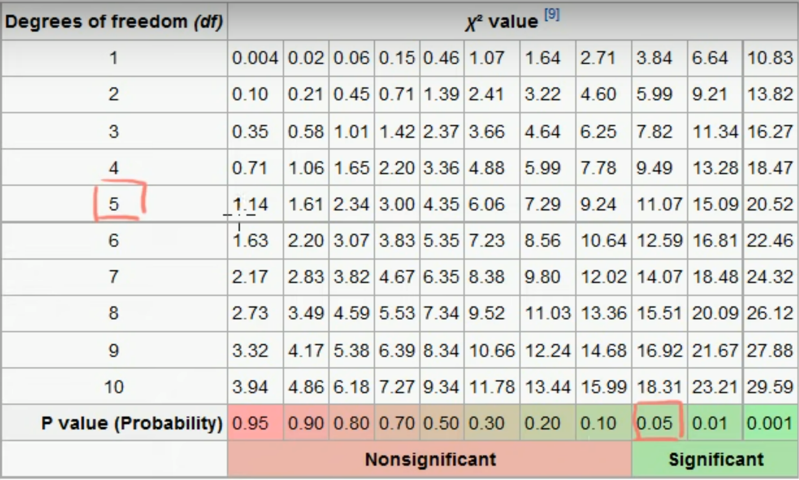
Chi-Square table

Slide 5
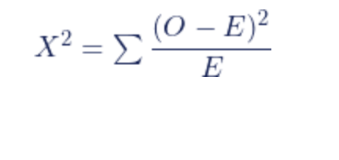
Chi-Square goodness of fit test
Define the hypothesis.
Calculate the Chi-square test statistic –
Find the degrees of freedom(df) - For chi-square goodness of fit tests, the df is the number of groups minus one.
Find Critical Chi-square value from the Chi-Square table using df and significance level.
Compare the chi-square value to the critical value i.e., if the Chi-square statistic value is greater, reject the null hypothesis, otherwise accept the null hypothesis.

Slide 6
When to use chi-square goodness of fit test
The following conditions are necessary if you want to perform a chi-square goodness of fit test:
The sample was randomly selected from the population.
There are a minimum of five observations expected in each group.

Slide 7
Example 1:
Problem Statement
A die was thrown 600 times and the following frequencies were observed
Test the hypothesis that the die is unbiased.
Face | 1 | 2 | 3 | 4 | 5 | 6
Frequency | 97 | 99 | 97 | 105 | 101 | 101

Slide 8
Example 1:
Solution
Step1:Define the hypothesis
Null hypothesis H0 : die is unbiased
Alternative hypothesis H1 : die is biased
Step 2: Set the Significance Level (alpha) to 0.05

Slide 9
Example 1:
Step 3:Calculate Chi-Square Value
Since we have assumed that die is unbiased, for each face we will take expected frequency as total no. of thrown divided by no. of face.
Observed(O) | Expected(E) | (O-E⁾² / E
97 | 100 | 0.09
99 | 100 | 0.01
97 | 100 | 0.09
105 | 100 | 0.25
101 | 100 | 0.01
101 | 100 | 0.01
600 | 600 | 0.46

Slide 10
Example 1:
Step 4:
Calculate the Critical Value from the Chi square table with significance level 0.05 and degrees of freedom (6-1)=5 which is 11.07.
Step 5:
Now critical value is 11.07 and chi-value we got is 0.46
As 0.46 < 11.07
Therefore we accept the Null hypothesis H0

Slide 11
Example 2:
Problem Statement
You have a bag of candies with different colors, and you want to test whether the observed distribution of candy colors in the bag matches the expected distribution. The expected distribution is provided by the candy manufacturer.
 | Red | Green | Blue | Yellow | Orange
Expected Distribution | 20% | 30% | 25% | 15% | 10%
Observed | 38 | 72 | 60 | 25 | 5

Slide 12
Example 2:
Solution
Step1:Define the hypothesis
Null Hypothesis (H0): The observed distribution of candy colors in the bag matches the expected distribution.
Alternative Hypothesis (H1): The observed distribution of candy colors in the bag does not match the expected distribution.
Step 2: Set the Significance Level (alpha) to 0.05

Slide 13
Example 2:
Step 3:Calculate Chi-Square Value
Observed(O) | Expected(E) | (O-E⁾² / E
38 | 0.20 * 200 = 40 | 00.10
72 | 0.30 * 200 = 60 | 02.40
60 | 0.25 * 200 = 50 | 02.00
25 | 0.15 * 200 = 30 | 00.83
5 | 0.10 * 200 = 20 | 11.25
200 | 200 | 16.58

Slide 14
Example 2:
Step 4:
Calculate the Critical Value from the Chi square table with significance level 0.05 and degrees of freedom (5-1)=4 which is 9.49.
Step 5:
Now critical value is 9.49 and chi-value we got is 16.58
As 16.58 > 9.49
Therefore we reject the Null hypothesis H0

Slide 15
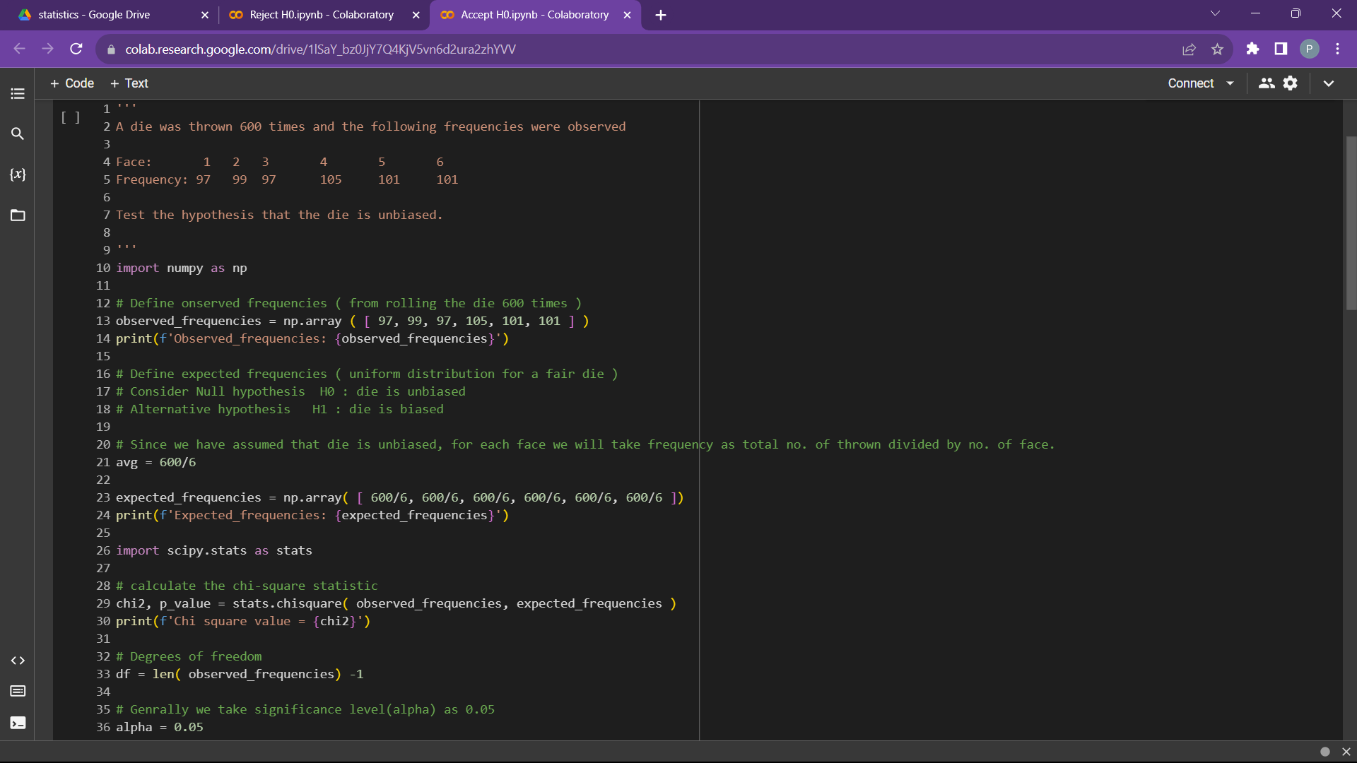
Code 1: Python code for Example 1

Slide 16
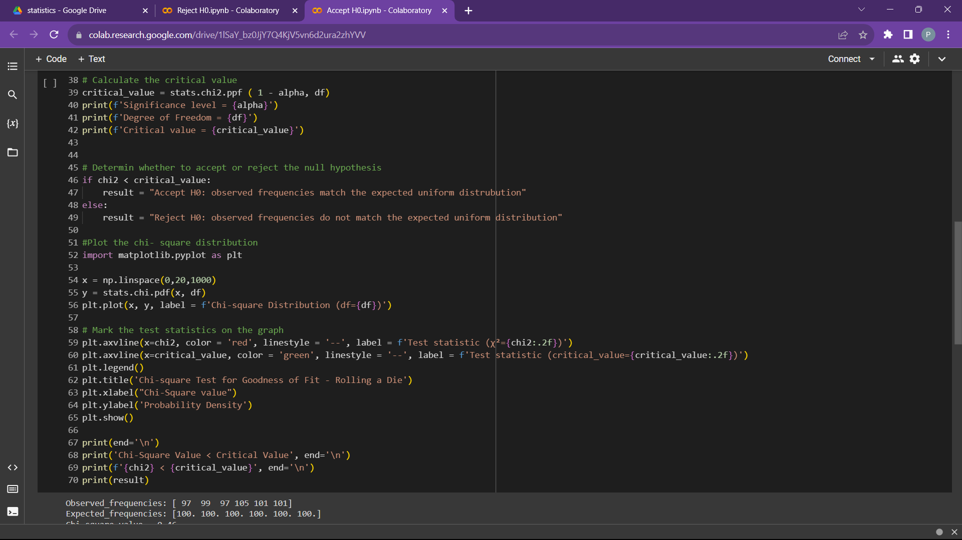
Code 1: Python code for Example 1

Slide 17
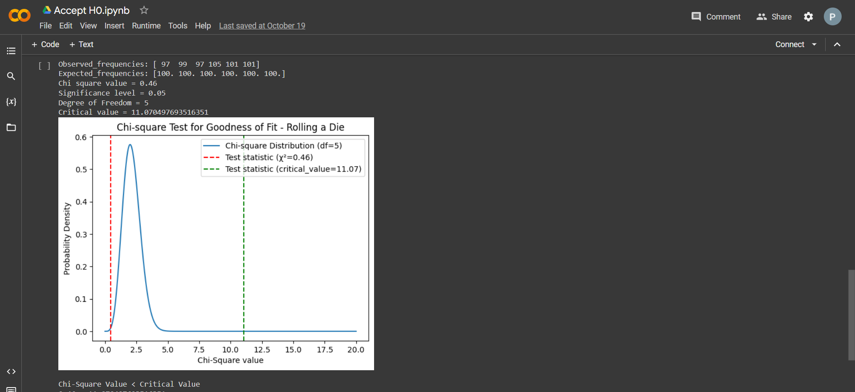
Output 1: Output of Code 1

Slide 18
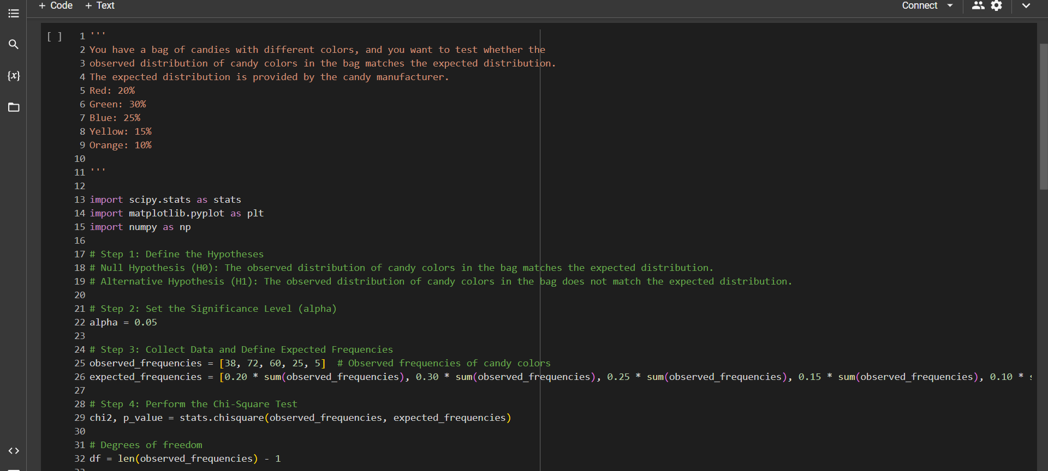
Code 2: Python code for Example 2

Slide 19
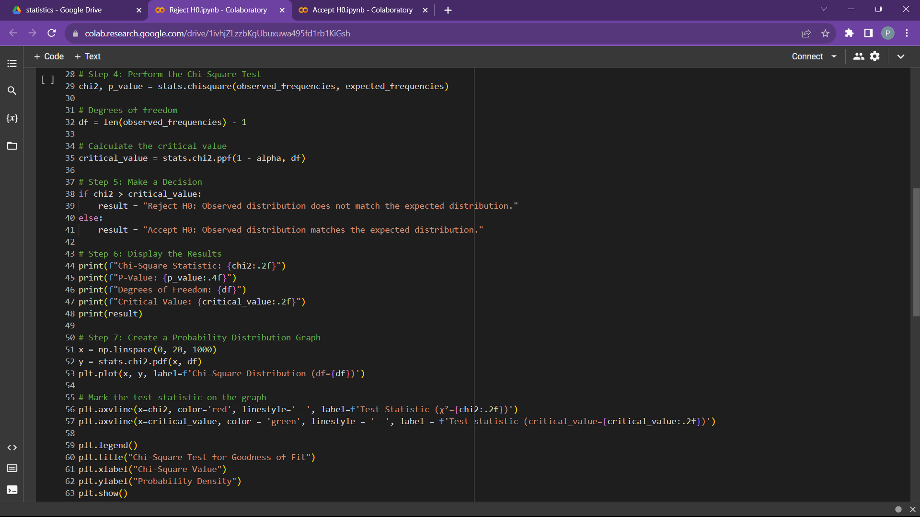
Code 2: Python code for Example 2

Slide 20
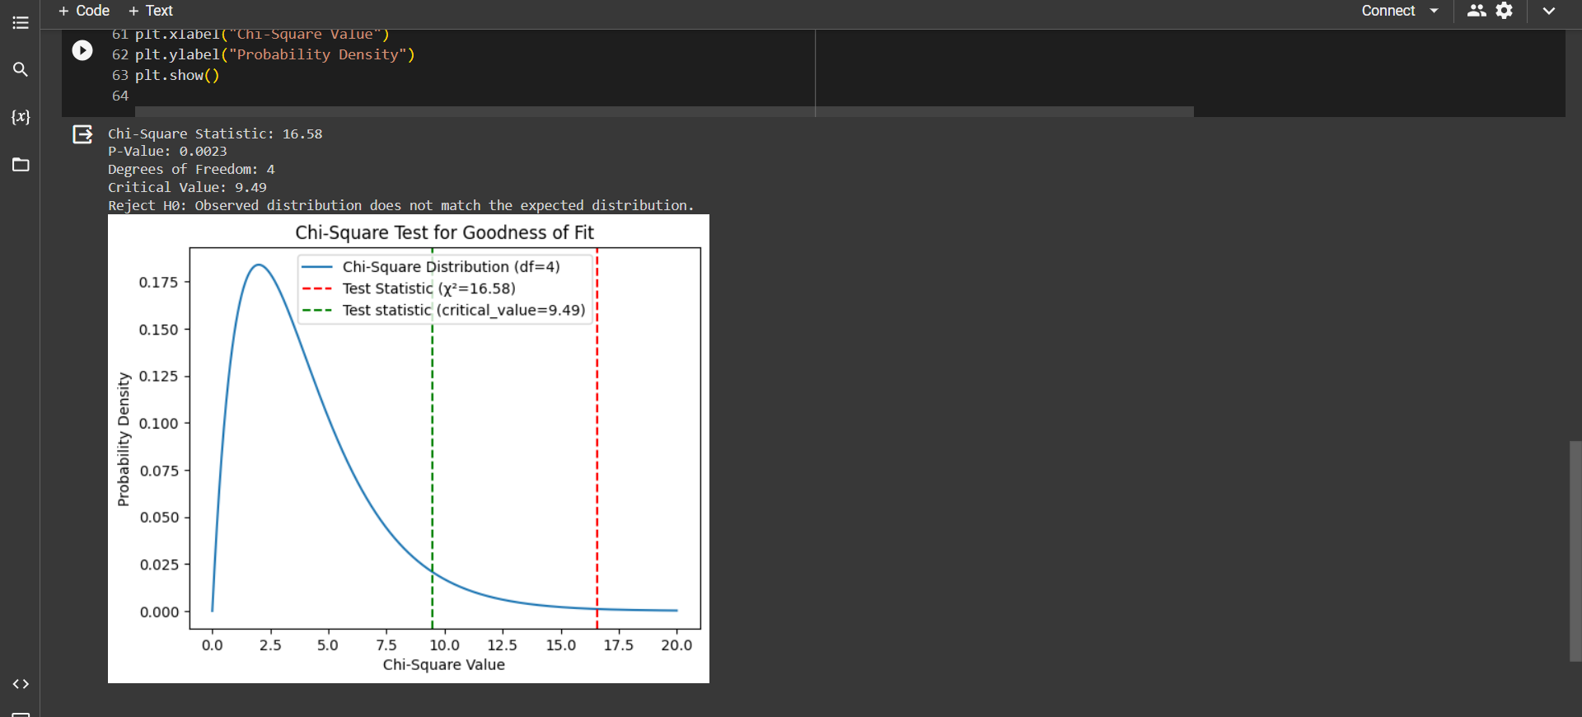
Output 2: Output of Code 2

Slide 21
References
YouTube: https://www.youtube.com/
NITC Statistics Study Material

Slide 22
Team
Prakash Singh(M210677CA)
Debayan Ghosh(M210656CA)
Prashant(M210704CA)

Slide 23

The End

